Slide 1
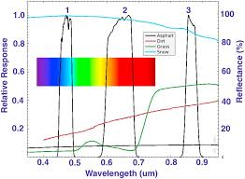
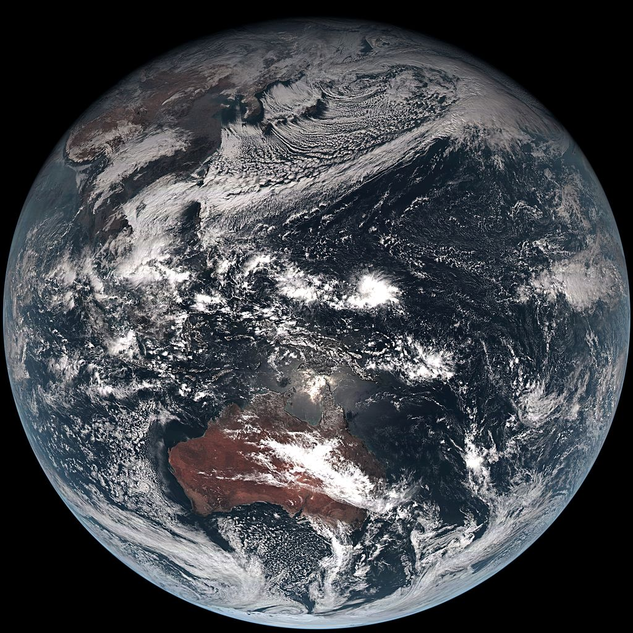
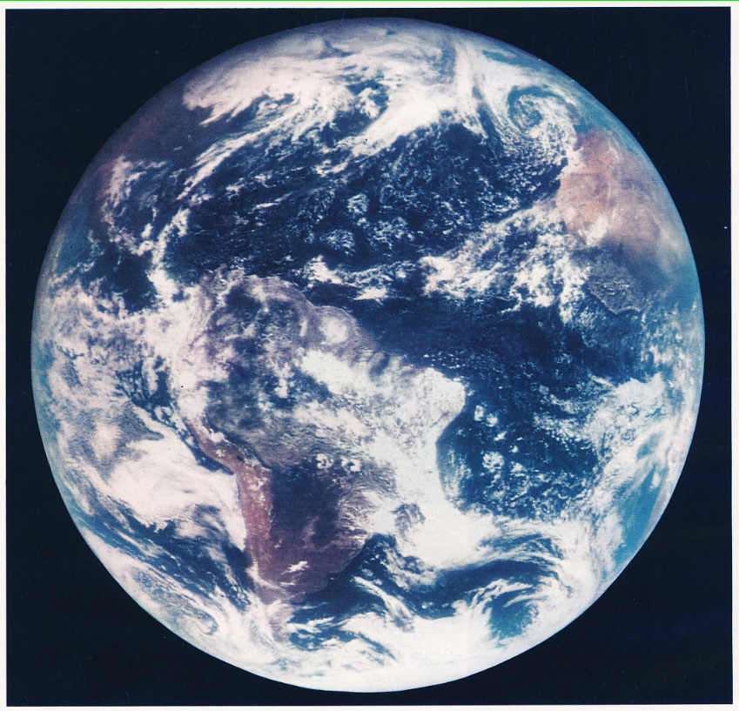
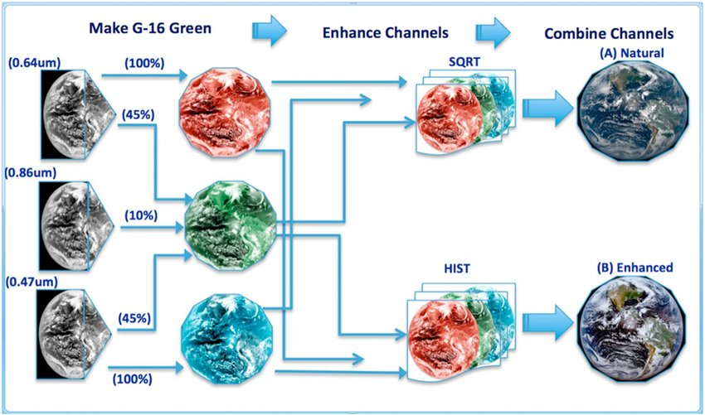
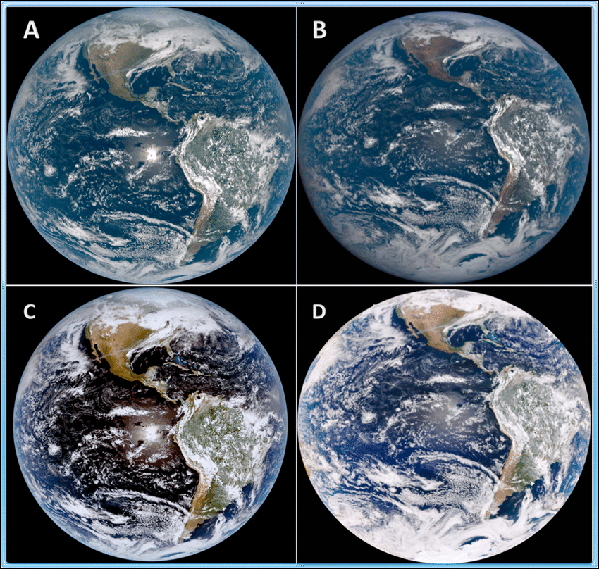
“True Color” of Earth Without Using a Green Band Through Fractional Combination
Julian Morales Grande
Results
Introduction
Geostationary Operational Environmental Satellite systems are used to gather data about the Earth in order to help organizations such as NASA, NOAA, and the National Weather Service to do research regarding weather, space sciences, and atmospheric and oceanic behavior. GOES systems use certain technology to read certain information better than others. The ABI (Advanced Baseline Imager), one component of the GOES satellites, uses spatial and temporal resolutions using 16 spectral bands at visible, and infrared wavelengths. ABIs can be modified mathematically and be programmed to recreate an image of Earth. It can be modified to recreate “true color” however, there are limitations at an attempt to recreate the true color of earth: there is no green band. Knowing the true color of Earth can make it easier for everyone see the conditions of our planet.
Hypothesis
Figure 1: showing visible wavelength spectrum and the bands that GOES-16 reads.
“True Color enhanced” of Earth from Himawari-8 satellite from Japan Meteorological agency (2014).
“True Color” of Earth from the US ATS and NASA.
Knowing that GOES-16 presents 16 spectral bands, two of which are only visible to humans (shown in Figure 1), we can simulate a green channel with a veggie band at 0.86, red at 0.64 um, and blue at 0.47 um and then fractionally combine the colors through a series of steps.
Research Procedure
To simulate a green band via fractional combination, a series of steps are done to recover true color images of Earth in two versions: natural color, and enhanced color. We take 100% of red at 0.64 um, and 100% of the blue at 0.47 um. To come up with a green channel, we fractionally combine green and red bands together by taking 45% of red at 0.64 um, 10% of the veggie band at 0.86, and 45% of blue at 0.47 um. To create the natural colored version of earth, you use square root enhancement. To create the enhanced colored version of Earth, you use the histogram equalized enhancement.
Summary
Figure 2: Fractional Combination procedure to show natural color or enhanced color of the Earth.
Creating a green channel through the use of fractional combination can be done by taking certain percentages of the available bands in the visible color spectrum that is read by GOES-16. Using a series of procedures of enhancing channels can help create a natural and enhanced image of the Earth. This information can make it easier to see environmental conditions, differences, and impacts of several variables.
Sources
Figure 1-2:
Bah, M. K., Gunshor, M. M., & Schmit, T. J. (2018). Generation of GOES-16 true color imagery without a green band. Earth and Space Science, 5, 549–558. https://doi.org/10.1029/2018EA000379
(a) CIMSS Natural Color, square root enhancement. (b) EPIC Natural color. (c) CIMSS enhanced, equalized histogram. (d) EPIC enhanced color.

